Slide 1
Internet of Things
By: Matthew Dinh

Slide 2
What is the Internet of Things?
The Internet of Things (IOT) is the network of modern devices that are constantly interacting with each other over the internet.
This can be better understood as the communication of devices to exchange information and communicate.
Examples can be seen all around us through our phones, cars, cameras, doorbells, computers, and other things we use on a daily basis.

Slide 3
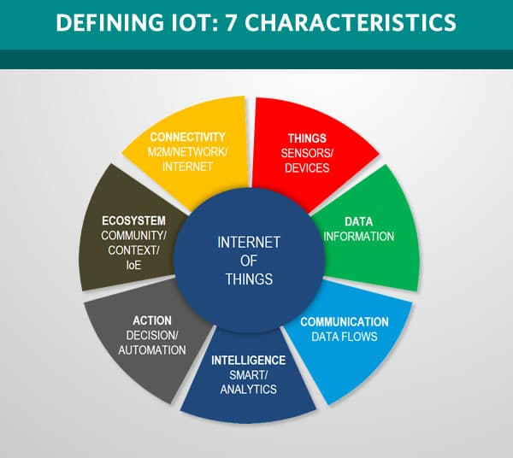

Slide 4
Why is it important?
The IOT is what connects the internet to our everyday lives.
Modern society is almost completely reliant on the technology, including the internet. Almost all technology on the internet are connected through the IOT.
Another reason why the IOT is so important is that it reduces the work needed to be done by humans and, instead, automates it to devices and sensors to do the same job.

Slide 5
Why is it important? (continued)
The ability for devices to be able to access cloud networks allows for smaller storage on the devices themselves and allows for more complex algorithms or computations to be done outside the device itself.
In fact, the IOT is something that we should be well familiar with. Without it, we would be unable to swipe into the buildings to be able to attend classes here, as our student ID's have a chip inside them that the college uses to recognize students and allow access.

Slide 6
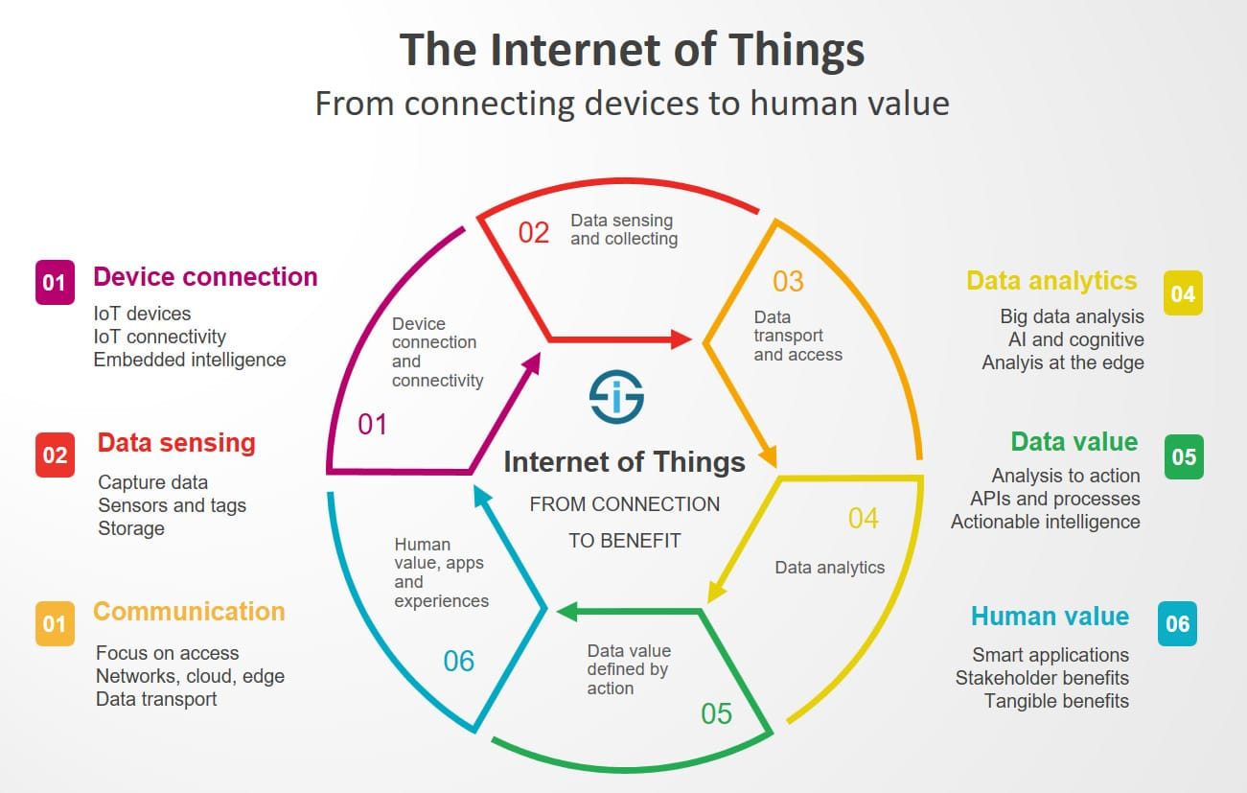

Slide 7
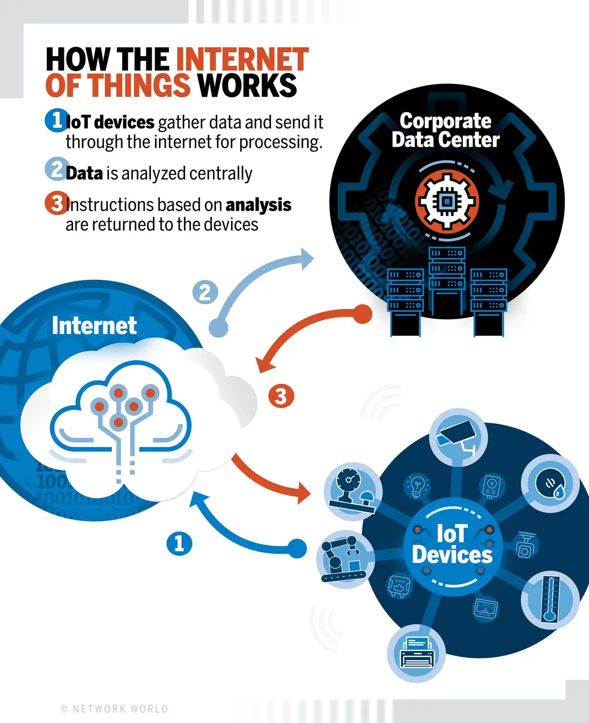

Slide 8
YouTube Breakdown of IOT
3:00 to 4:15

Slide 9
IOT and HTML
IOT devices act as the hardware that HTML and other languages are ran on to have value for humans.
IOT devices can either take data from a page through the internet or collect data to later display on a page using HTML.
As technology improves, more and more devices are beginning to be able to access the internet, like our refrigerators or watches, which means websites that use HTML must become more responsive to a wider variety of devices.

Slide 10
IOT and Artificial Intelligence
How do they work together?

Slide 11
How does IOT and Artificial Intelligence Interact?
So, we now know how IOT works. Artificial Intelligence (AI) can be used in this process to collect and analyze given data taken from sensors or other devices.
Companies and businesses are using AI together with IOT to simulate intelligent decision making without human interaction and to predict possible future data, finding patterns or relationships in the data.

Slide 12
Benefits of the use of AI with IOT
AI in the use of IOT in businesses can provide many benefits and open many possibilities.
Increases efficiency by making smart decisions without the need of a person, improving processes or algorithms by itself, or recognizing patterns or relationships in data.
Automates risk calculations and responses to certain processes.
Allows incoming data from other devices on the IOT to be summarized and sent to other devices in a more compact way.
Can handle, learn from, and predict future issues and resolve them in an optimized manner.

Slide 13
Examples of AI in IOT
Self-driving Cars
Data from self-driving car routes are recorded and used to optimize future routes and driving using AI predictions and calculations.
Retail Analytics
Data from consumer sales can be used with AI to regulate storage and predict future sales and products that will sell well.
Manufacturing Robots
AI can monitor and record the activities of manufacturing robots to detect inefficiency, errors, or possible future improvements.

Slide 14
Examples of AI in IOT (continued)
Traffic Monitoring and Management
Data collected overtime from traffic can be used to further optimize traffic light wait times or traffic flow.
Autonomous Delivery Robots
Uses AI to calculate how to traverse terrain using data incoming from its sensors to observe its environment and surroundings.
Large-scale monitoring and calculations for vehicles, such as trucks, planes, or ships.
Distance traveling can be made quicker and easier with devices on the IOT on the vehicle sending data to the AI to calculate how much fuel will be needed for a certain amount of distance and possible repairs or maintenance that will be needed.

Slide 15
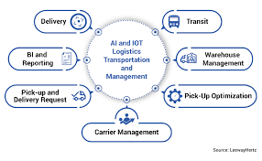

Slide 16
Siri, Cortana, Alexa
These digital assistants are one of the biggest forms of the use of AI in IOT.
Siri, on iPhones, or Cortana, on Windows computers, both use text or voice data and analyze it to understand the person's intentions and to complete the correct task on the web or device.
Alexa takes this to another level, being interconnected throughout homes through multiple devices and interacts with these devices.
Examples of Alexa interaction: door locks, light switches, security cameras
All this interaction through one Amazon Echo and the IOT
Alexa also can record data and send it back to Amazon to further improve performance and sales data.

Slide 17
Works Cited
Burgess, Matt. “What Is the Internet of Things? Wired Explains.” WIRED UK, 16 Feb. 2018, https://www.wired.co.uk/article/internet-of-things-what-is-explained-iot.
Marr, Bernard. “What Is the Artificial Intelligence of Things? When AI Meets IOT.” Forbes, Forbes Magazine, 20 Dec. 2019, https://www.forbes.com/sites/bernardmarr/2019/12/20/what-is-the-artificial-intelligence-of-things-when-ai-meets-iot/?sh=15caa4a7b1fd.
Shingadesy21. “What Is the Use of HTML in IOT.” Bolt Forum, 27 June 2019, https://forum.boltiot.com/t/what-is-the-use-of-html-in-iot/2986.
Vinugayathri. “Ai and IOT Blended - What It Is and Why It Matters?” Clarion Tech, https://www.clariontech.com/blog/ai-and-iot-blended-what-it-is-and-why-it-matters.
“What Is the Internet of Things (IOT)?” What Is the Internet of Things (IoT)?, https://www.oracle.com/internet-of-things/what-is-iot/.
“Why Are AI and IOT Perfect Partners for Growth?” Reply, https://www.reply.com/breed-reply/en/content/why-are-ai-and-iot-perfect-partners-for-growth.

Slide 18
Media Sources (In Order)
https://www.i-scoop.eu/internet-of-things-iot/
https://www.jessevandoren.com/en/internet-of-things-iot/
https://www.networkworld.com/article/3207535/what-is-iot-the-internet-of-things-explained.html
https://youtu.be/6mBO2vqLv38
https://www.leewayhertz.com/develop-logistics-management-software/

