Slide 1
2024 Student Case Competition
Determining How to Classify Stock Investments: The Case of Unbekannt, INC.

Slide 2
Objectives
Define the Equity Method and who is eligible to use it.
Compare and contrast the Fair Value Method and the Equity Method.
Analyze Results

Slide 3
Defining The Equity Method

Slide 4
FASB Accounting Standards Codification
323-10-05-4
The equity method is an appropriate means of recognizing increases or decreases measured by generally accepted accounting principles (GAAP) in the economic resources underlying the investments. Furthermore, the equity method of accounting closely meets the objectives of accrual accounting because the investor recognizes its share of the earnings and losses of the investee in the periods in which they are reflected in the accounts of the investee. The equity method also best enables investors in corporate joint ventures to reflect the underlying nature of their investment in those ventures.

Slide 5
FASB Accounting Standards Codification
323-10-15-6
Ability to exercise significant influence over operating and financial policies of an investee may be indicated in several ways, including the following:
Representation on the board of directors
Participation in policy-making processes
Material intra-entity transactions
Interchange of managerial personnel
Technological dependency
Extent of ownership by an investor in relation to the concentration of other shareholdings (but substantial or majority ownership of the voting stock of an investee by another investor does not necessarily preclude the ability to exercise significant influence by the investor).

Slide 6
Unbekannt, Inc. Financial Statements for Year Ended December 31, 2022

Slide 7
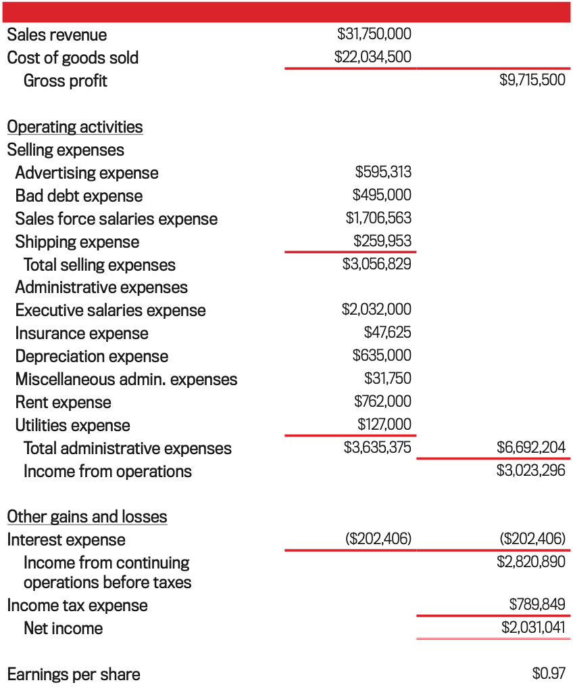
The Income Statement

Slide 8
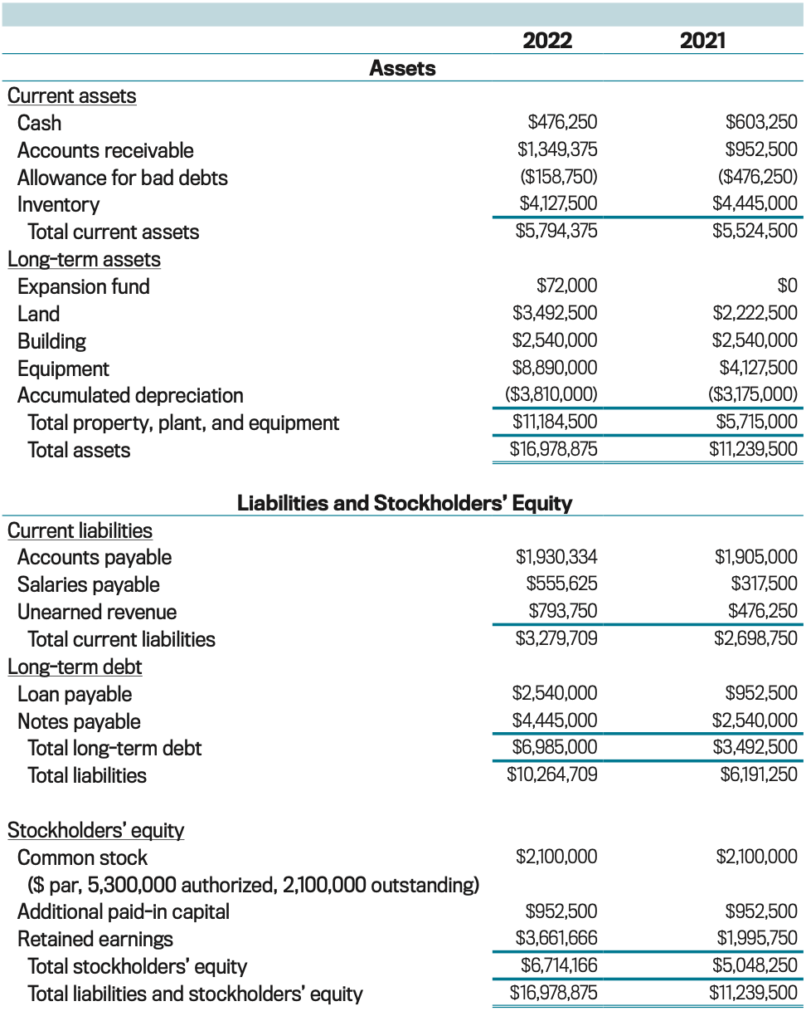
The Balance Sheet

Slide 9
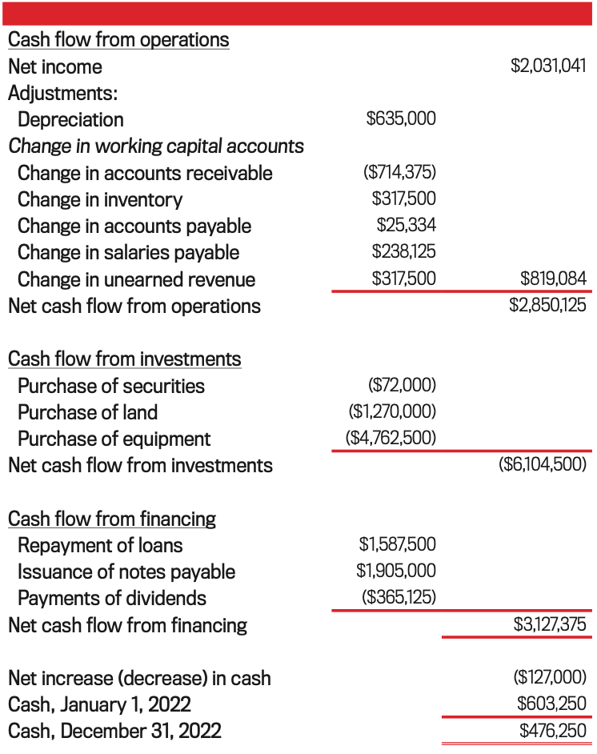
The Statement of Cash Flows

Slide 10
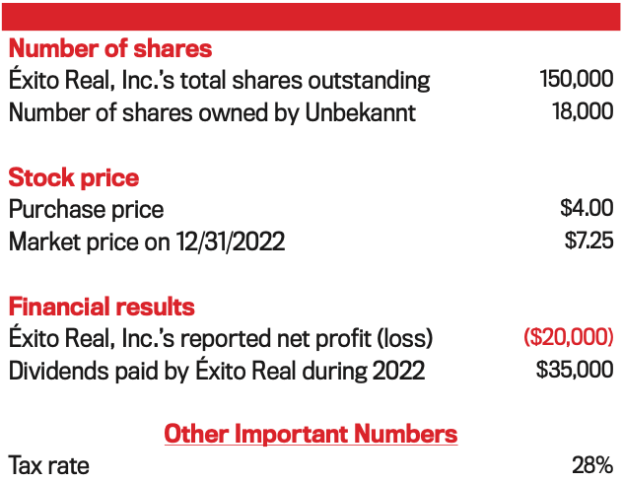
Investment in Éxito Real, Inc.

Slide 11
The Fair Value Method Adjusting Entries

Slide 12
Initial Entry
Account | Debit | Credit
Expansion Fund | 72,000.00
Cash |  | 72,000.00

Slide 13
Subsequent Entries for Fair Value
Account | Debit | Credit
Cash | 4,200.00
Dividend Income |  | 4,200.00
Account | Debit | Credit
Expansion Fund | 58,500.00
Investment Income |  | 58,500.00

Slide 14
Effects on Income Statement
Dividend Income
Increases by $4,200.00
Investment Income
Increases by $58,500.00
Income Statement Adjusted Net Income
$2,093,741​
Total Liabilities & Equity
$17,041,575

Slide 15
Effects on Balance Sheet
Current Assets
Cash Balance Increases by $4,200.00
Long-Term Assets
Expansion Fund Balance Increases by $58,500.00
Balance Sheet Adjusting Totals
Current Assets
$5,798,575.00
Long-Term Assets
$11,243,000.00
Total Assets
$17,041,575.00

Slide 16
The Equity Method Adjusting Entries

Slide 17
Initial Entry
Account | Debit | Credit
Expansion Fund | 72,000.00
Cash |  | 72,000.00

Slide 18
Subsequent Entries for the Equity Method
Account | Debit | Credit
Equity Investment in Éxito Real, Inc. | 2,400.00
Expansion Fund |  | 2,400.00
Account | Debit | Credit
Dividend Receivable | 4,200.00
Expansion Fund |  | 4,200.00
Account | Debit | Credit
Cash | 4,200.00
Dividends Receivable |  | 4,200.00

Slide 19
Effects on Balance Sheet
Current Assets
Cash Balance Increases by $4,200.00
Long-Term Assets
Expansion Fund Decreases by $6,600.00
Balance Sheet Adjusting Totals
Current Assets
$5,524,500.00
Long-Term Assets
$11,430,000.00
Total Assets
$16,954,500.00

Slide 20
Results

Slide 21
The Equity Method
After analyzing the effects of both the Fair Value Method and the Equity Method, our team has concluded that the evidence supports that Unbekannt, Inc. should move forward with implementing the Equity Method.

