Slide 1
SQL
1
Structured Query Language

Slide 2
What is SQL?
2
SQL is the language used to preform actions such as update,
retrieve, manipulate and store data on a relational database,

Slide 3
interesting facts
3
-SQL was developed by IBM Donald D. Chamberlin and Raymond F. Boyce in the early 1970s
-it was initially called SEQUEL that is (structured English query language )
-SQL is powerful language that uses a simple English sentences
-SQL is a Declarative Language

Slide 4
Features
4
-SQL has well-defined stranders
-SQL is easy to learn
-With the help of SQL, one can create multiple views
-Portability of code in SQL is a prominent feature

Slide 5
data and data base
5

Slide 6
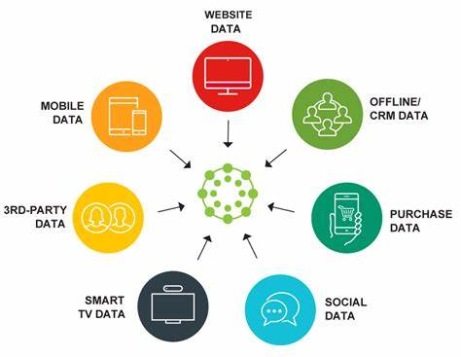
What is data ?
6
https://www.lotame.com/the-hard-and-fast-rules-of-data-collection/

Slide 7
What is Database?
Database is an organized collection of data where the data is stored and accessed electronically from computer system.
7
Databases kinds:
-Distributed database
-Object oriented database
-Centralized database
-Operational database
-Graph database
-NoSQL database
-Cloud database
-Relational database

Slide 8
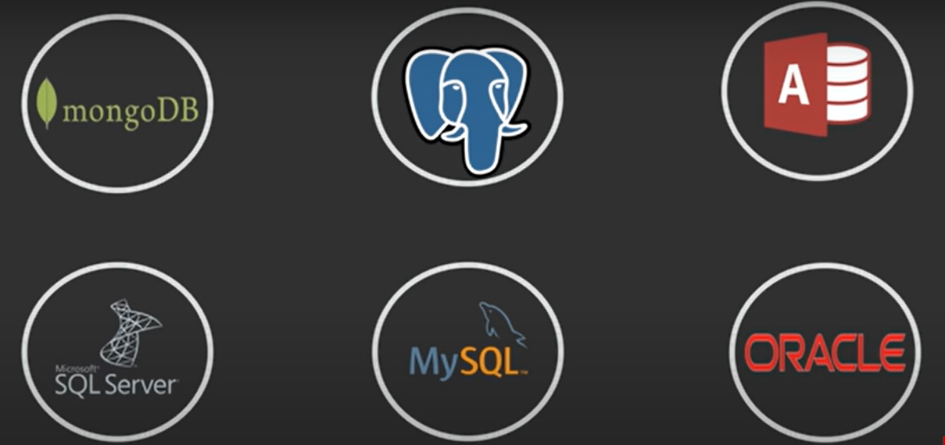
8
Few popular Databases

Slide 9
What is a Table
9
A table in database Is nothing but a collection of data in tabular way it consists of rows and columns, the table contains data elements also known as values using a model of vertical columns and horizontal rows

Slide 10
Summary
10
-What is SQL
-What is data, database, table
-Some basic SQL queries

Slide 11
Thank you
11

