Slide 1
Governance of the Web
A look behind the curtain
By Geno Casceillo

Slide 2
Governance
The action or manner of governing.

Slide 3
What is Web Governance?
Web governance is all the policies and procedures which go into maintaining and managing a website
All the rules and acts that are performed by people managing websites and domains

Slide 4
Guard Rails

Slide 5
DA ECOSYSTEM

Slide 6
Freedom on the Web
I
II
III
IV

Slide 7
People take the internet seriously too (I know surprising)
Different companies use the internet to help customers
4 Horsemen Of Governing a website
Penske
Epic Games
YouTube
FBI
Microsoft
Development: developing the website
Maintenance: Making sure the website doesn’t fall apart in the future
Infrastructure: The background of keeping accounts and data working in tandem with the website
Leadership: Supervisor

Slide 8
Resources
Resources are what we use to create and govern websites

Slide 9
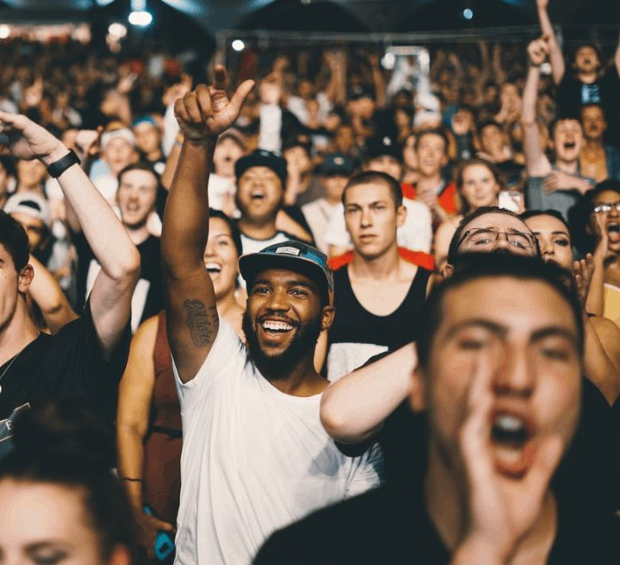
People
The demographic the website is appealing to
The People that can perform the roles seen before

Slide 10
Tools
What service you are going to use to
Maintain
Govern
Create

Slide 11
Budget
You cannot create anything without a Budget
Using budgeting skills, you can create what you want and the way you want it
Money makes the world go round

Slide 12
How does the government “surf the web”?
The internet is run by different branches
IGF
ICANN
ITU
IETF
IEEE

Slide 13
IGF
MEDIA
They make sure everything is equal and everyone can be heard

Slide 14
ICANN
Make sure domain names are safe
Sell and Buy
Stabilizes the internet

Slide 15
ITU
Wireless
5G

Slide 16
The Internet Engineering Task Force
(IETF) is a large open international community of network designers, operators, vendors, and researchers concerned with the evolution of the Internet architecture and the smooth operation of the Internet

Slide 17
IEEE
IEEE is the world’s largest technical professional organization dedicated to advancing technology for the benefit of humanity. Below, you can find IEEE's mission and vision statements

Slide 18
Wrap Up Gene
Big Picture VS Little Picture
Guard Rails
Different companies
How Websites are ran
How we protect the internet and YOUR data

